Slide 1


Slide 2

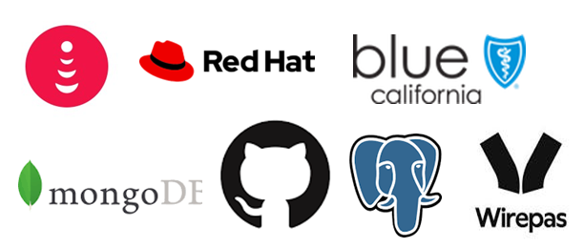
Flagship Program to bring together
Infosys Architecture & Tech Community
Building Technology Depth across Roles
Nurturing Symbiotic Ecosystem
Technology Thought Leadership in Industry
Culture of Sharing, Contributing and Adopting
5000+ Architects, 3000+ Power Programmers, Digital Specialists, and Technology Leaders
External Thought Leaders & Communities
External Thought Leaders
External Tech Communities
Arch & Tech Focused Analysts
Client & Partner Tech Community
1400+ Clients, 50+ Strategic partners, 300+ Academic Institutions, Opensource technology communities

Slide 3
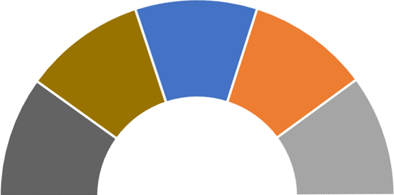
With a Vision for Wholistic development
Strategic Thought Leadership
Tech Trend Reports,
Survey, Research and Analysis
Macro Technology Shifts
Energizing Tech Community
Global Technology Chapters
Technology Career Streams
Reward and Recognition
Deeper Client Relevance
Reference Architecture Repos
Tech Client Stories & Learnings
Client Advisory Board
Differentiated IP & Reuse
Evangelize & Enable
Rewarding IP Reuse
Collaborative Ecosystem
Deeper Partner Engagement
Joint Publication with Partners
2-way Collaboration with Academia
Key Focus Areas
AI
DATA
CLOUD
UX
API
LCNC
DEVSECOPS
CYBERSEC
BIZOPS
Open Source
Digital WPS

Slide 4
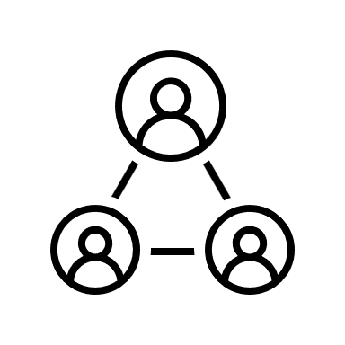




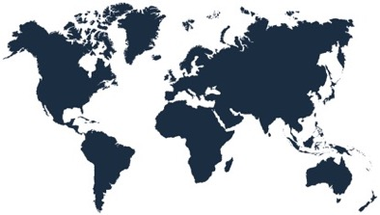








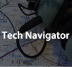
Milestones in Journey so far
In-person Meetups – 50+
25 Global Chapters
across 5 Regions
Tech Focus Areas - 11
Hands-on Workshops - 17
Show & Tell - 6
Technology sessions – 600+
Quarterly WIT events - 6
Monthly Newsletters - 17
Industry Experts – 75++
Academicians – 15+
White Papers - 54
Partners - 34 & Clients - 7
Ref Architectures - 36
Contests & Hackathon
Rewards & Recognition
Technology Trends
TechCompass
Tech Thought Leadership TechNavigator

Slide 5
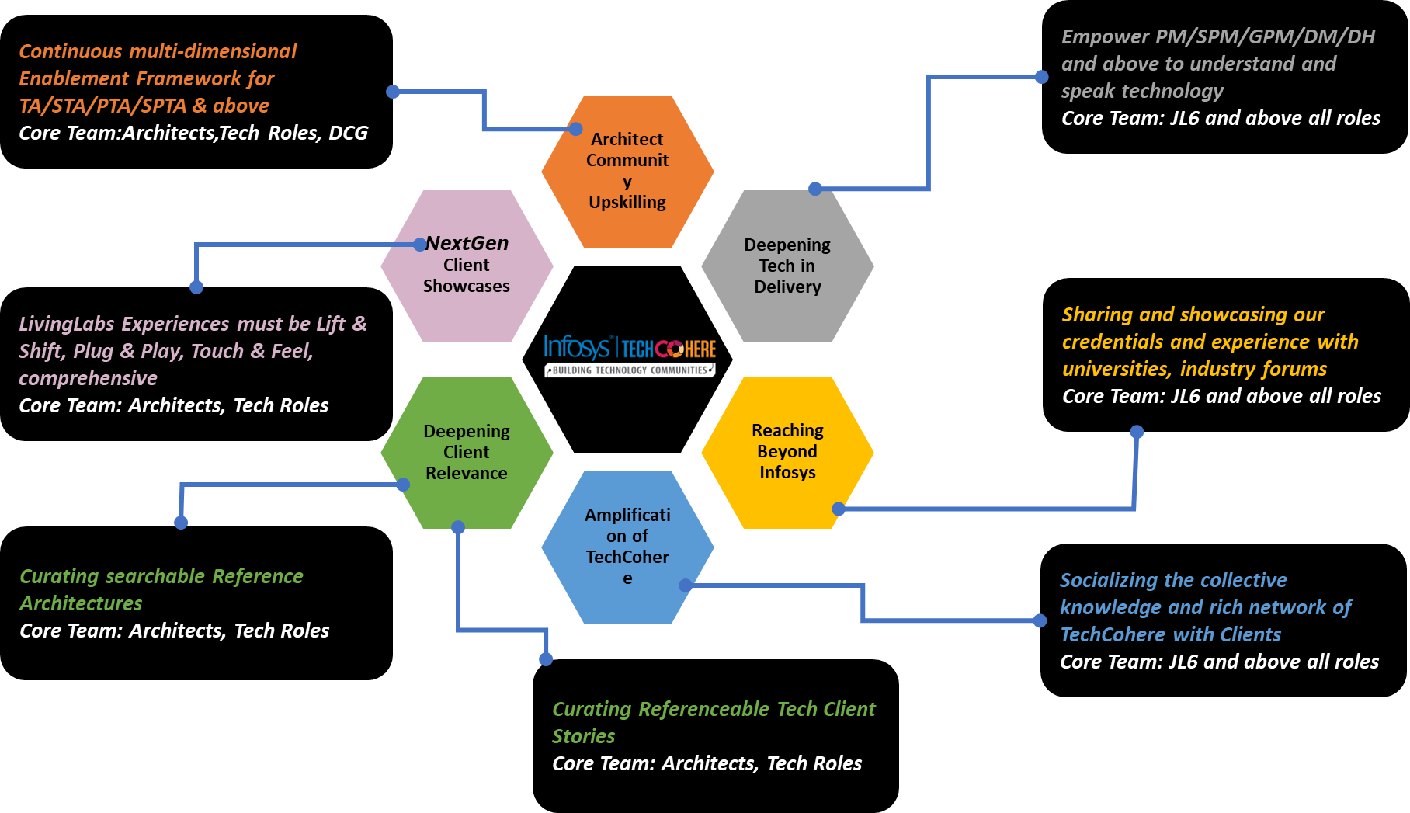
Key Focus Areas

Slide 6
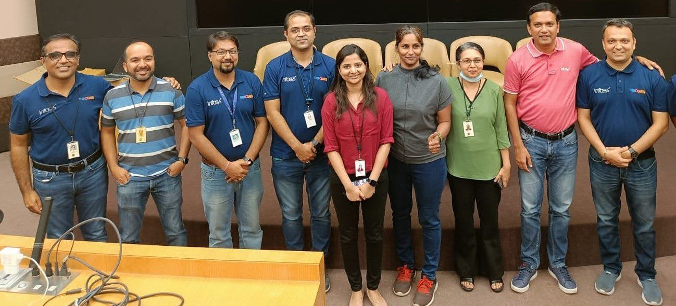
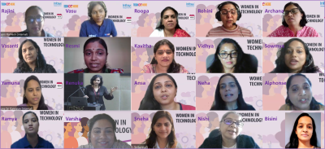
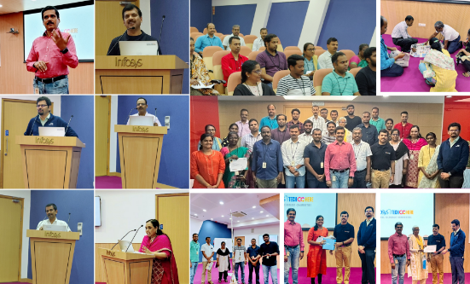
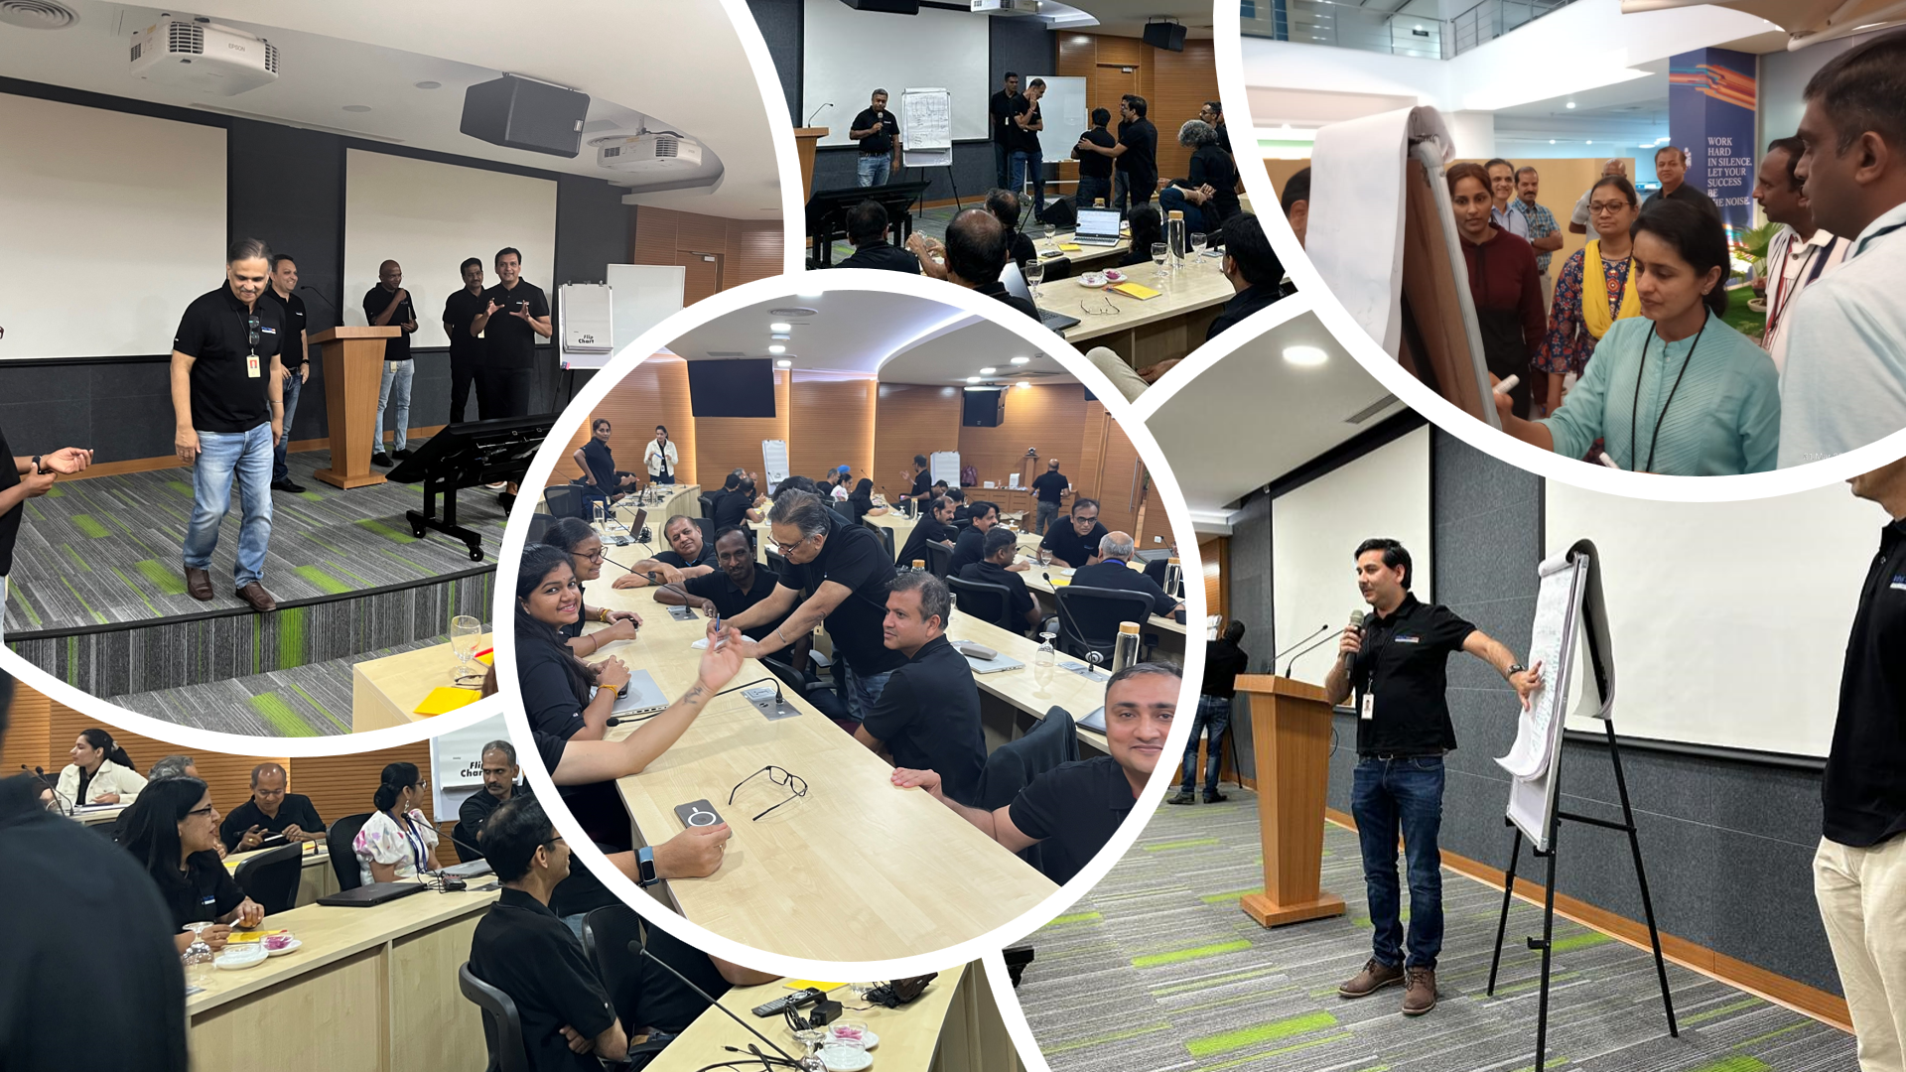
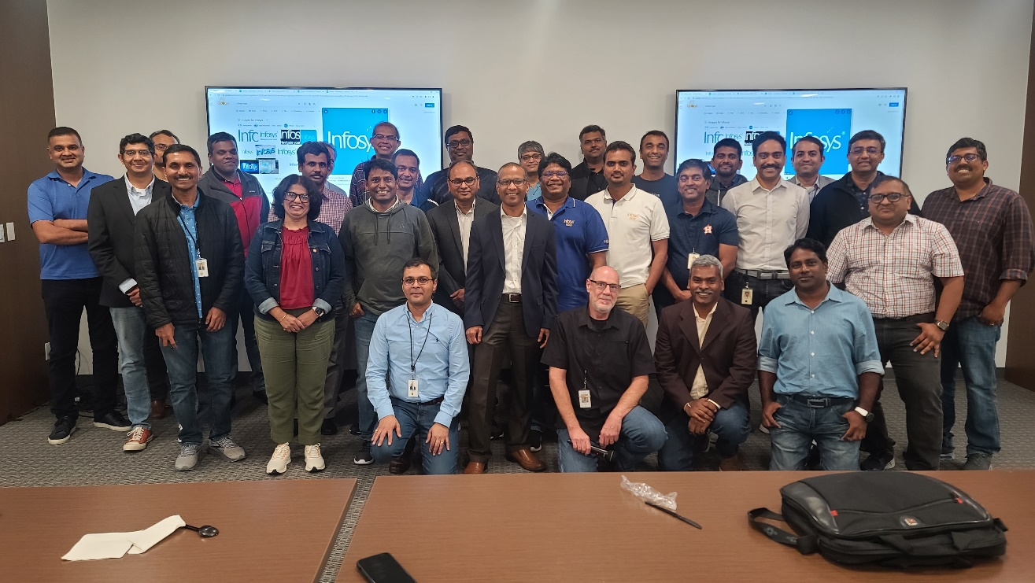
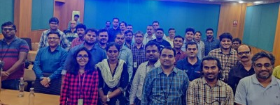
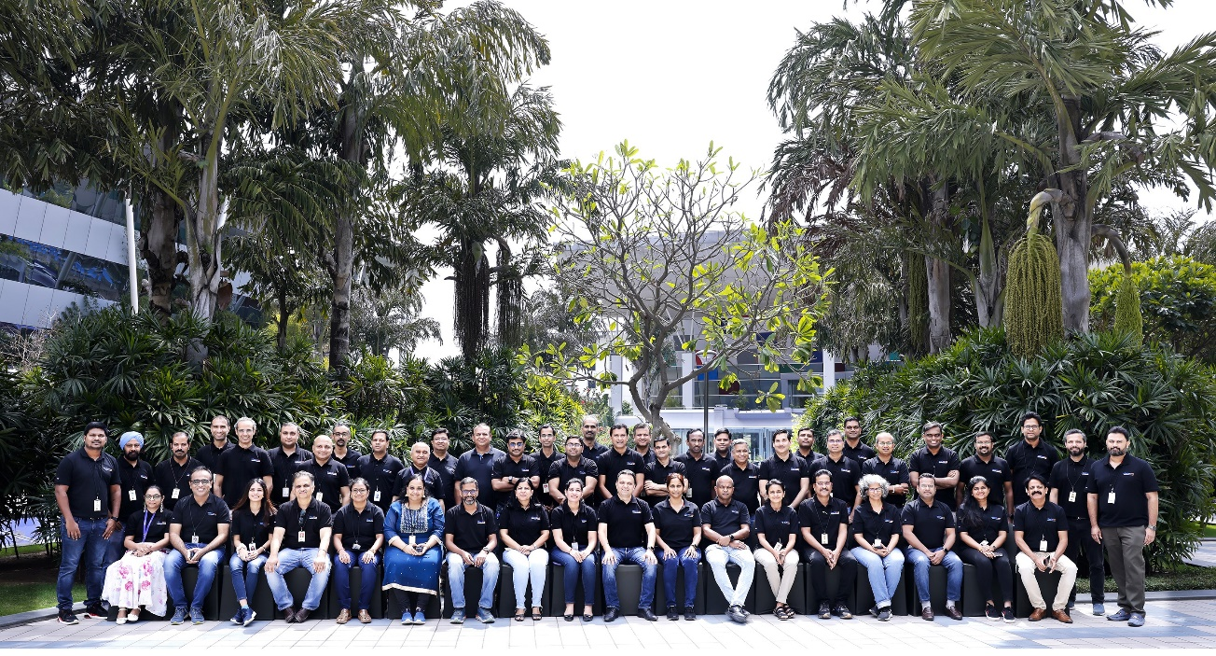
Bringing it all to Life

Slide 7
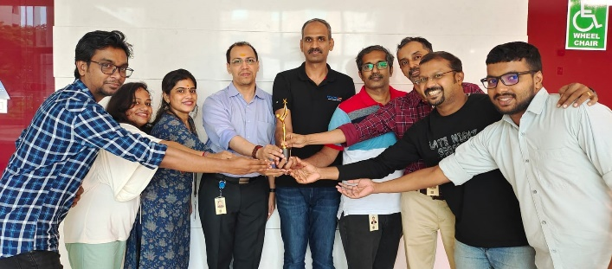
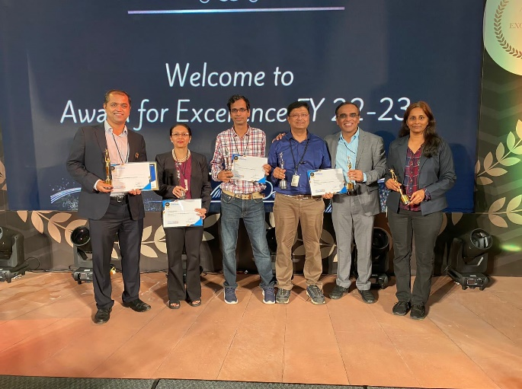
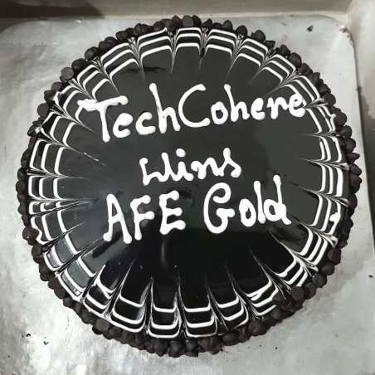
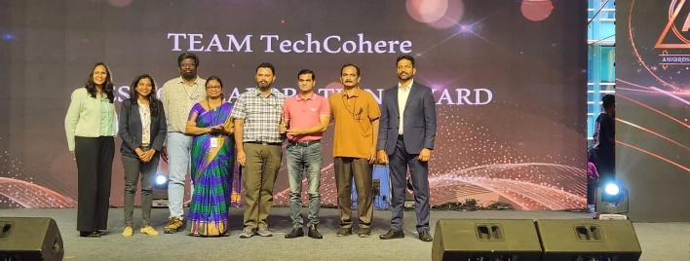
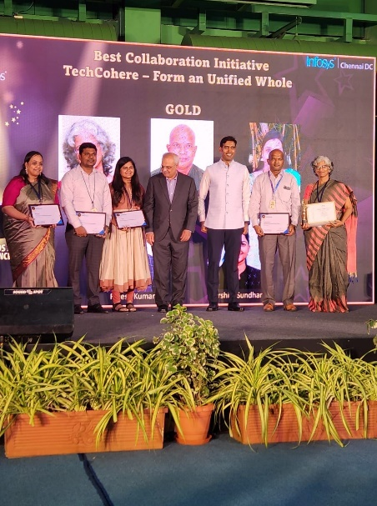
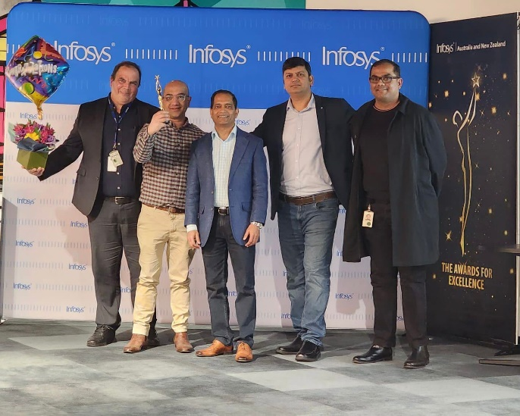
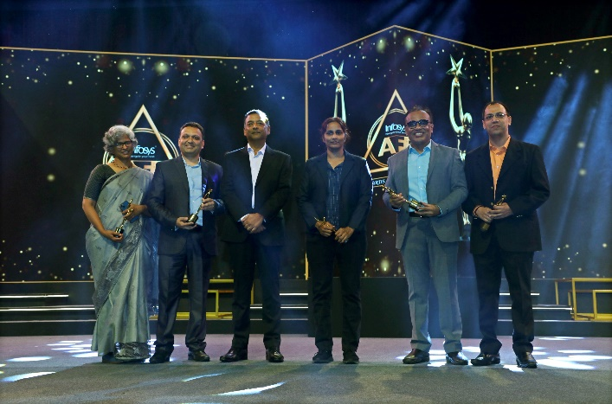
Org Recognition

Slide 8
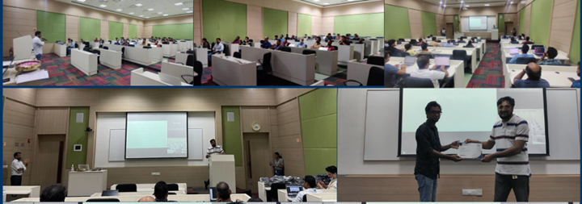
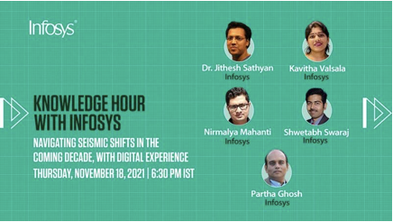
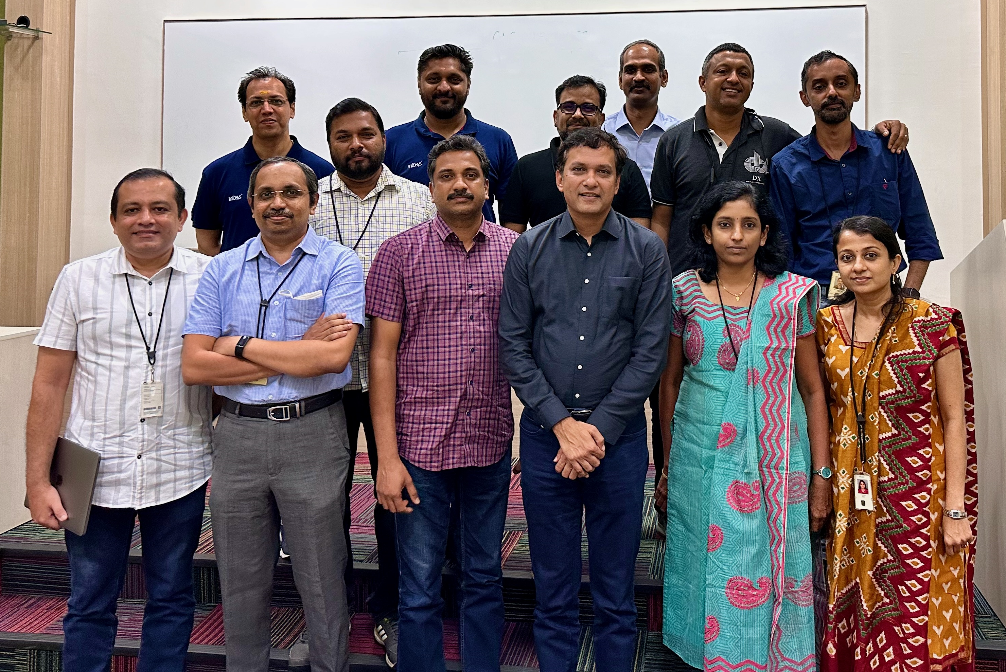
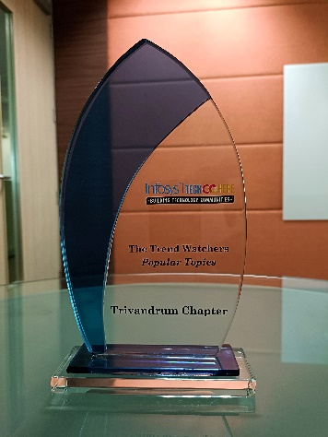
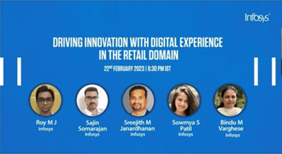
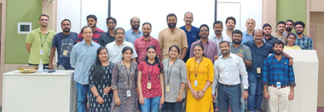
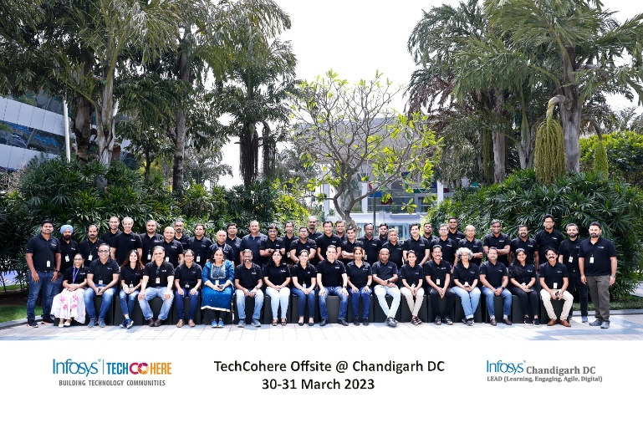
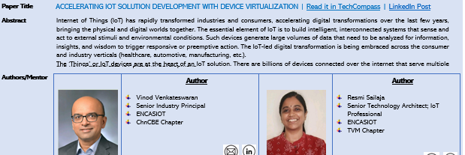
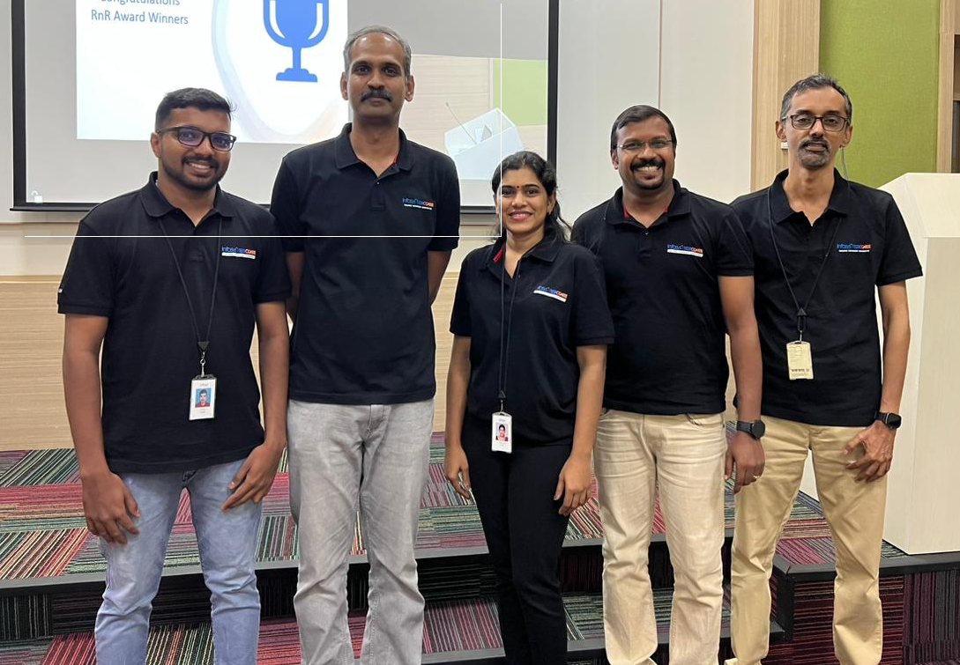
Trivandrum chapter snippets

